Slide 1

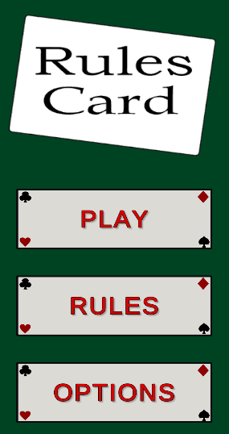
Rulescard’s gameplay
Notes:
Video script - Hello, I am Evan, and I will be going over the gameplay of our project Rulescard.

Slide 2

Game overview
Rulescard is a digital card game created using unity. It is a turn-based game with the main focus being the fact that the user can select whatever rules they want to be enabled, creating gameplay that is very flexible.
Notes:
Video script - It is a turn-based digital card game with the key feature being that the user is able to select any rule to be enabled from the given set, which makes the game very flexible.

Slide 3
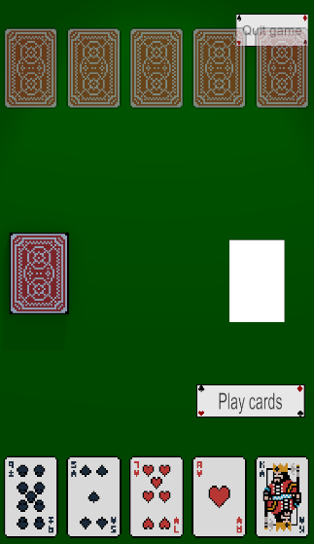
Gameplay
The player and the AI take turn selecting what cards to play.
The selected rules determine what cards can be played/what the win conditions for the game is.
The game will check the played cards against the selected rules and will block any invalid moves.
Notes:
Video script - For the actual game, the player and the AI take turns selecting cards to play, with the game checking if the cards can be played based on the current rules. If they can be played, there an animation of the cards being played and it switches turns. If the selected cards are against the rules, then a message pops up telling the player what rule they are breaking.

Slide 4
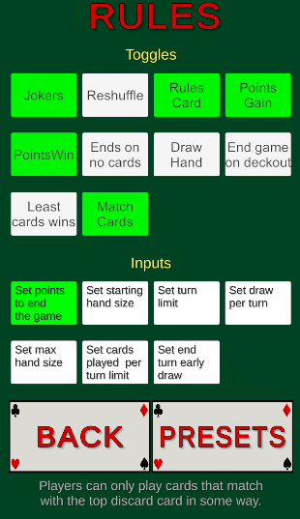
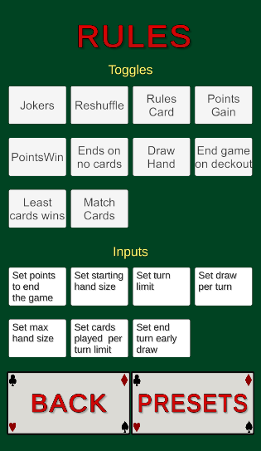
The Rules
The player is able to select the rules from the Rules menu available from the main menu.
When they select a rule, the rule turns green, notifying the player that that rule is selected. The selected rule also has a description telling the player what it does.
To play the game, the player must select a rule which determines when the game will end, along with a rule that determines the winner.
Notes:
Video script - The player selects the rules from the rules menu with the buttons turning green if they are selected (Transition), as you can see there. After selecting a rule, you are also given a description of what the rule is at the bottom of the screen. To play the game, an end rule and a win rule need to be selected, otherwise the game will give the user a message telling them to get one.

Slide 5
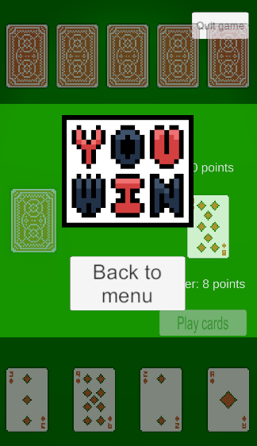
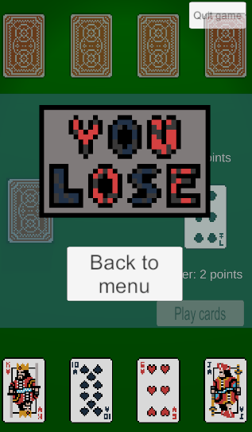
Overall
Overall, the player choses what rules are enabled for the game, and then the game uses a rules system to determine what actions the player and the AI are allowed to take and what those actions do.

